Slide 1
Fantasy or reality?
Investigating Popular Fantasy Football Draft Strategy

Slide 2
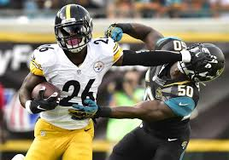
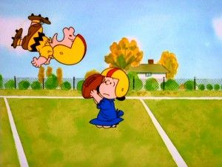
If you play fantasy football, you are familiar with two popular rules of thumb:
1. Draft a running back first
2. Draft a kicker last

Slide 3
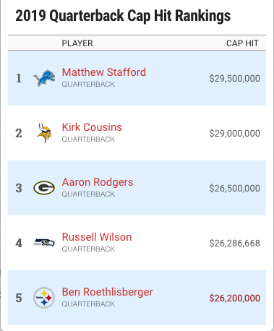
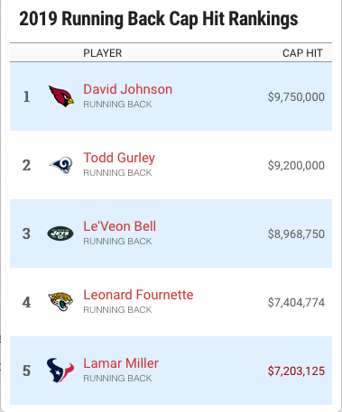
Even as the NFL becomes a pass-centric game where quarterbacks receive record contracts and the value of running backs seems to be dwindling…

Slide 4
2019 DRAFT RANK | NAME | TEAM | POS
1 | Saquon Barkley | NYG | RB
2 | Alvin Kamara | NO | RB
3 | Christian McCaffrey | CAR | RB
4 | Ezekiel Elliott | DAL | RB
5 | David Johnson | ARI | RB
6 | Nick Chubb | CLE | RB
7 | James Conner | PIT | RB
8 | DeAndre Hopkins | HOU | WR
9 | Dalvin Cook | MIN | RB
10 | Davante Adams | GB | WR
11 | Odell Beckham Jr | CLE | WR
12 | Todd Gurley | LAR | RB
13 | Joe Mixon | CIN | RB
14 | Julio Jones | ATL | WR
15 | Tyreek Hill | KC | WR
16 | Le'Veon Bell | NYJ | RB
17 | JuJu Smith-Schuster | PIT | WR
18 | Travis Kelce | KC | TE
19 | Mike Evans | TB | WR
20 | Michael Thomas | NO | WR
… | … | … | …
43 | Patrick Mahomes | KC | QB
…experts still tout running backs as the top picks in fantasy drafts.
In fact, Patrick Mahomes, the top fantasy scorer of 2018, ranks # 43 in 2019 fantasy draft projections; the highest of any quarterback.
Does that make sense?

Slide 5
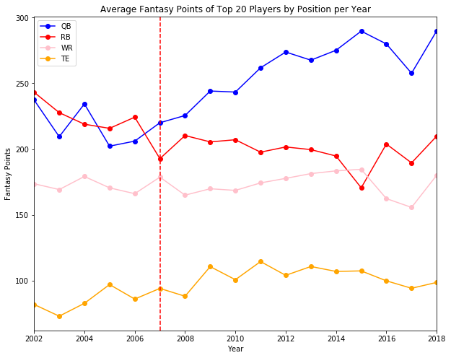
Over the last 17 years, the average fantasy point totals for quarterbacks has drastically increased while running back fantasy scoring has been on the decline.
Meanwhile, wide receivers have been relatively steady and tight ends have seen a very slight rise.

Slide 6
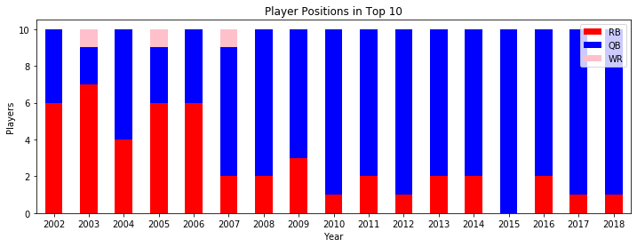
In recent years, quarterbacks have become the highest scoring players in fantasy football.
In fact, the top 10 fantasy scorers in 2015 were ALL quarterbacks.

Slide 7
If quarterbacks are outscoring running backs, why do running backs receive the higher draft projections?
Shouldn’t you pick the highest scoring players first?
Which position really provides the most value towards winning in fantasy football: quarterback or running back?

Slide 8
assumptions
Standard scoring according to ​ESPN Fantasy​. No points per reception, though that could affect the results of the analysis.
Fantasy team rosters allow for starting 1 quarterback, 2 running backs, 2 wide receivers, 1 tight end.
Real-world situations like player trades and injuries will impact total fantasy points but are not taken into consideration during analysis of the data.

Slide 9
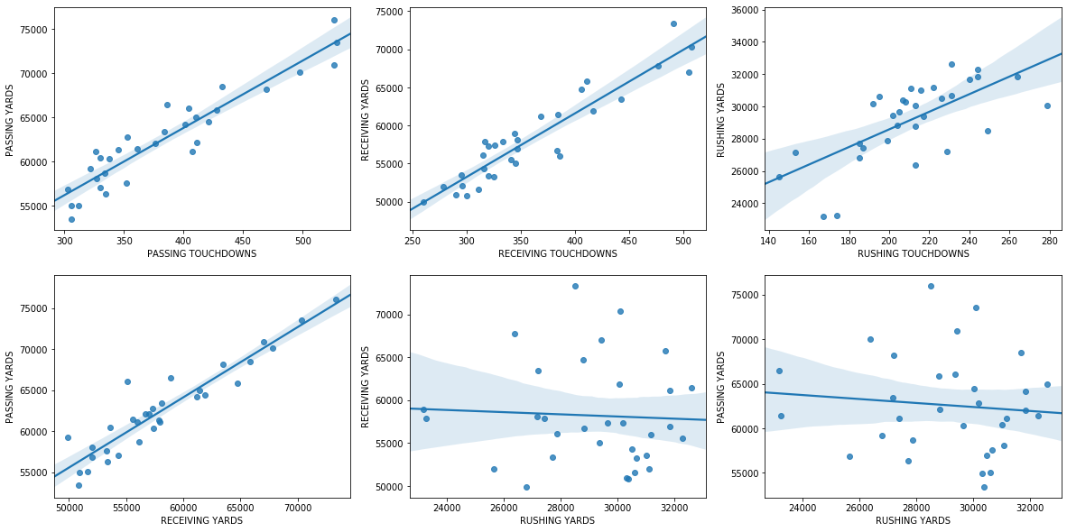
First, are there statistical correlations between the two positions?
Some correlations are obvious, like passing yards and passing TD’s.

Slide 10
However, rushing yards and rushing TD’s have a noticeably lower correlation.

Slide 11
Passing yards and receiving yards also have an understandably high correlation…

Slide 12
…but passing yards and rushing yards do not seem correlated at all.

Slide 13
What does all this mean?
The relatively low correlation between rushing yards and rushing TD’s could indicate that running back produce mostly short yardage gains with scoring coming frequently from shorter runs.
Passing yards and rushing yards have no correlation, so quarterback and running back fantasy values are statistically independent of each other.

Slide 14
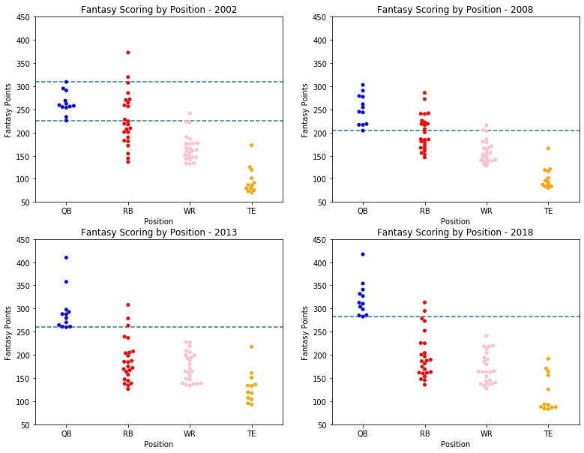
Using the concept of “starters”, a 12 team league would have 12 QB’s, 24 RB’s, 24 WR’s and 12 TE’s as the most relevant players.
In 2002, the entire starting QB group scored about the same as the mid-tier starting RB’s
By 2018, starting QB’s outscored all but two starting RB’s.

Slide 15
Meanwhile, fantasy scoring of “starting” wide receivers and tight ends remains fairly consistent.
How can this be considering the rapid rise in quarterback production? Who is catching all these passes?
Likely second, third or fourth options on NFL teams’ depth charts.

Slide 16
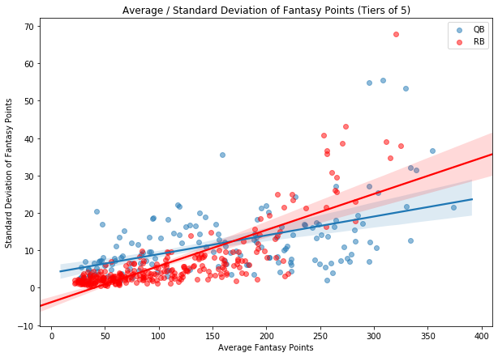
Which position’s scoring is more consistent?
Top tier running backs appear to have much higher variation than top tier quarterbacks.
Tiers of high-mean, low-variation quarterbacks are far more numerous. Most running backs are low-mean and low-variation.

Slide 17
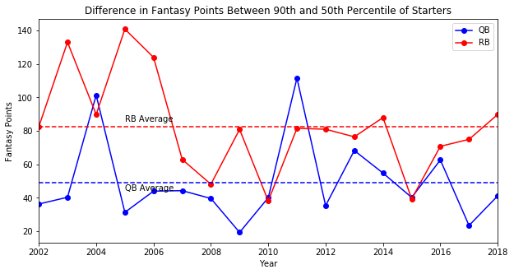
If top tier running backs have greater variance, how rare are high performers?
The drop in fantasy scoring from top to middling starting running backs has been, with few exceptions, consistently greater than that amongst quarterbacks.

Slide 18
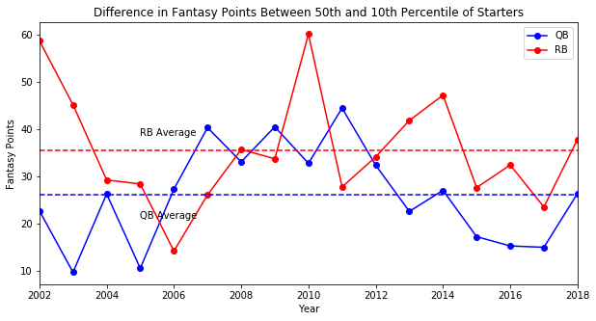
The drop from middling to bottom starting running backs has also been consistently greater than that amongst quarterbacks.

Slide 19
Quarterbacks:
Running Backs:
Score more fantasy points
Scoring is on the rise
Lower variance = more options
Double the roster spots to fill.
Scoring is rebounding the last couple of seasons.
Higher variance = fewer options
Which do you pick??

Slide 20
Draft simulation
12 teams comprised of 1 QB, 2 RB’s, 2 WR’s and 1 TE selected from the top 300 fantasy players of each year from 2002 through 2018.
Snake draft where picking order is reversed every round.
To add variation into the draft process, each pick is a random selection from the top 9 players available.
Simulation was run 1000 times for each year and the highest scoring team was captured from each run.
The goal is to analyze the player composition of the 1000 highest scoring teams from each year to determine which position had the greatest impact.

Slide 21
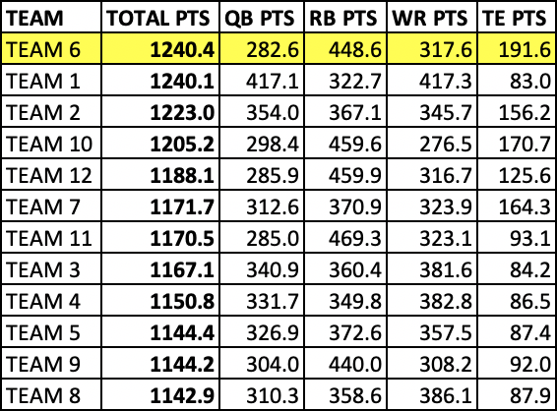
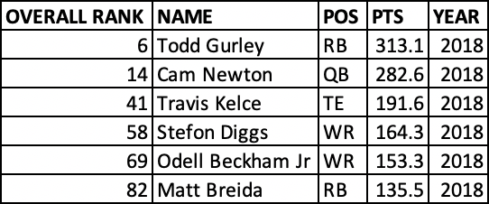
One simulation for 2018 using no random picks. The highest scoring team drafted a top running back first.

Slide 22
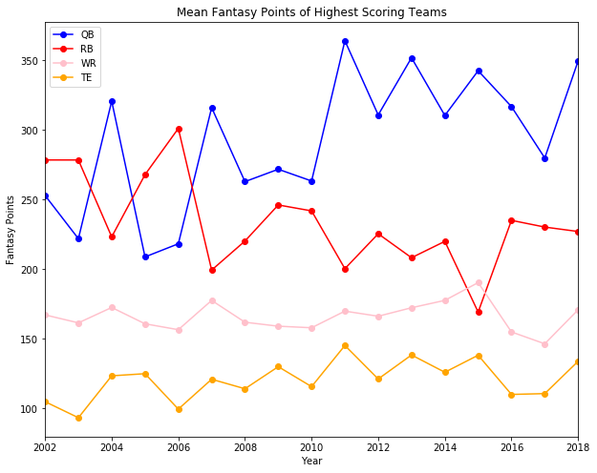
The mean fantasy points of each position on the highest scoring simulated teams appear to follow a trend similar to the means of the positions as a whole we saw earlier, albeit more extreme.

Slide 23
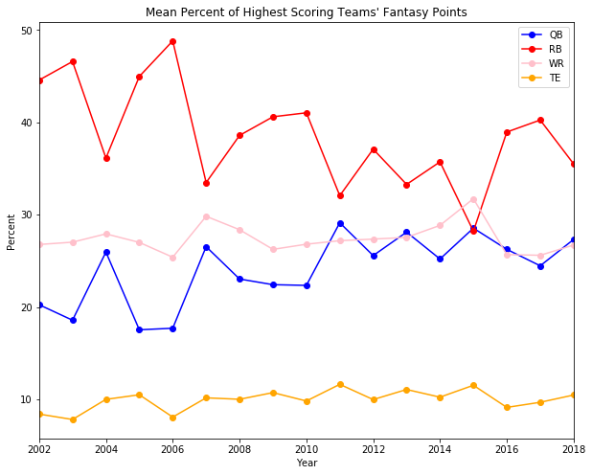
The percentage of points per position on the highest scoring teams favors running backs, but that is understandable given the 2:1 ratio of roster spots on the team.
Amazingly, the percentages scored by running backs and quarterbacks seem completely inverse of each other.

Slide 24
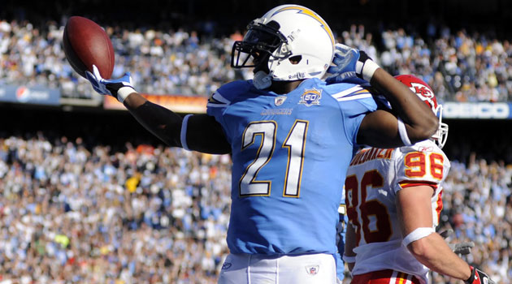
In 2006, LaDainian Tomlinson (RB) scored 28 rushing touchdowns (still an NFL record), rushed for over 1800 yards, caught passes for over 500 yards and 3 touchdowns and even passed for 2 touchdowns. His 425.1 total fantasy points that year were nearly 100 more than the next highest scoring player.
Through 1000 simulations of 2006 fantasy drafts, he was present on 82.4% of the highest scoring teams.
2006
NAME | POS | %
LaDainian Tomlinson | RB | 82.4
Antonio Gates | TE | 11.6
Steven Jackson | RB | 11.5
Peyton Manning | QB | 10.4
Alge Crumpler | TE | 9.4

Slide 25
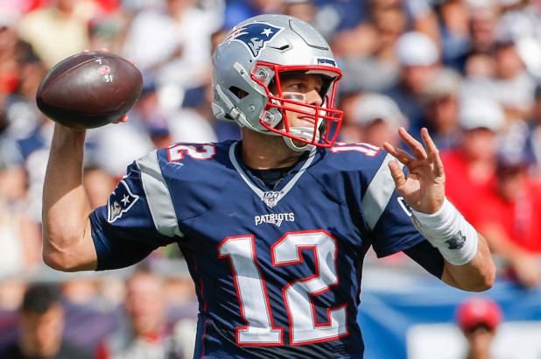
It’s not just running backs.
The following year, Tom Brady (quarterback) threw for a then NFL record 50 TD’s and over 4800 yards with only 8 interceptions.
His total fantasy points that year were 90 more than the next player (Tomlinson).
Through simulations of 2007 fantasy drafts, Brady was present on 50.0% of the highest scoring teams compared to Tomlinson at 25.8%
2007
NAME | POS | %
Tom Brady | QB | 50
LaDainian Tomlinson | RB | 25.8
Randy Moss | WR | 18.9
Brian Westbrook | RB | 14.4
Antonio Gates | TE | 13.3

Slide 26
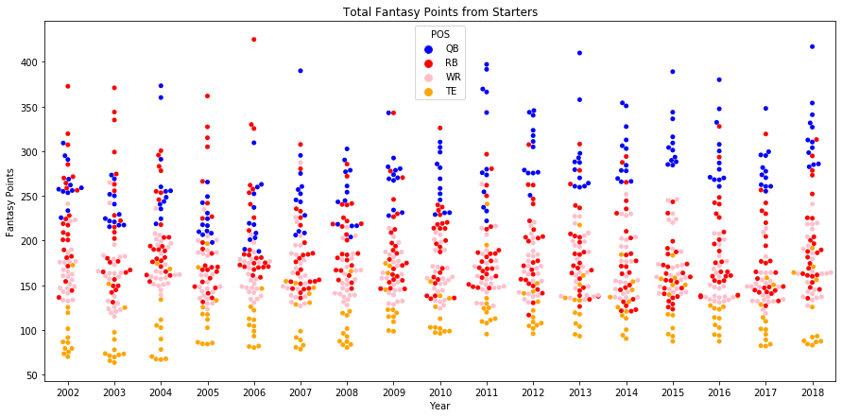
Every year there are a few players who drastically outperform the rest. However, those players are not always the most common on the simulated highest scoring teams
Tomlinson
Brady

Slide 27
Case in point: in 2009, Aaron Rodgers (QB) and Chris Johnson (RB) scored practically the same amount of fantasy points with 342.96 and 342.90 respectively.

Slide 28
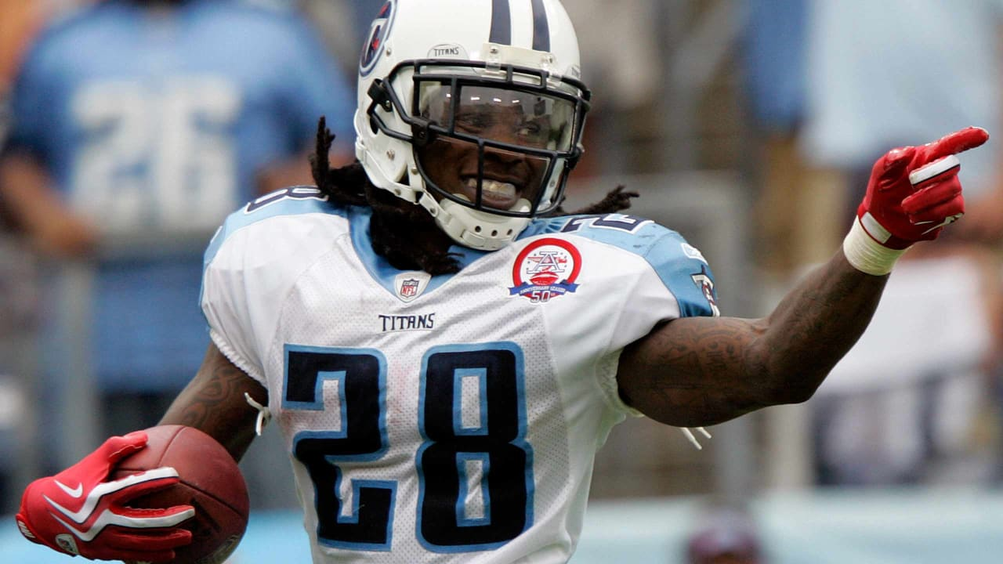
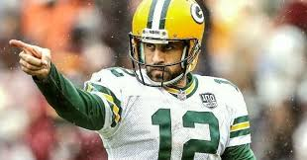
However, Chris Johnson was on 60.4% of the highest scoring fantasy teams compared to Aaron Rodgers at 21.4%
Advantage: running back.
2009
NAME | POS | %
Chris Johnson | RB | 60.4
Aaron Rodgers | QB | 21.4
Steve Smith | WR | 15.5
Adrian Peterson | RB | 14.6
Maurice Jones-Drew | RB | 13

Slide 29
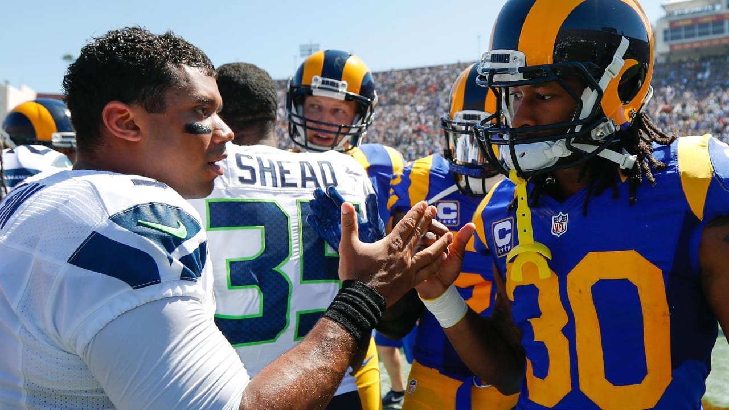
This trend can be seen as recently as 2017 when Russell Wilson (QB) ranked #1 in fantasy points and Todd Gurley (RB) ranked #2.
Yet, Todd Gurley was on 57.2% of the simulated highest scoring teams and Russell Wilson was on only 19.9%
2017
NAME | POS | %
Todd Gurley | RB | 57.2
Russell Wilson | QB | 19.9
Le'Veon Bell | RB | 17
Alvin Kamara | RB | 14.4
Kareem Hunt | RB | 13.7

Slide 30
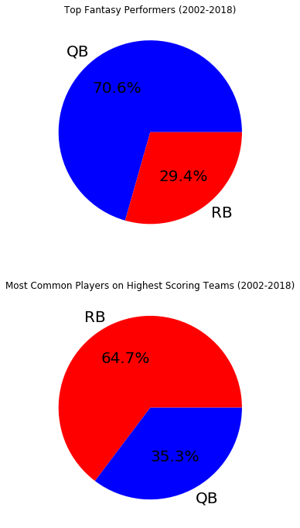
Since 2002, 12 of the last 17 top fantasy performers have been quarterbacks and the rest have been running backs.
Over this same timespan, 11 out of the 17 most common players on the 1000 highest scoring simulated teams of each year were running backs and the rest were quarterbacks.

Slide 31
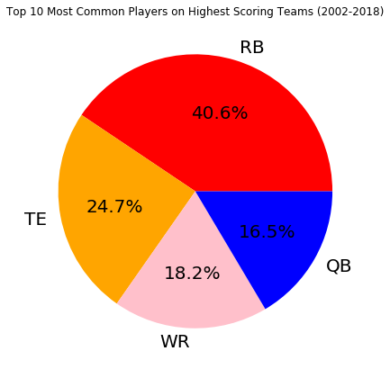
The results of the simulation suggest that high performing running backs are the most common players amongst the highest scoring teams since 2002.
2018
NAME | POS | %
Patrick Mahomes | QB | 36.3
Todd Gurley | RB | 24.2
Alvin Kamara | RB | 19.6
Saquon Barkley | RB | 19
Christian McCaffrey | RB | 17.3
Tyreek Hill | WR | 15.5
Eric Ebron | TE | 15.2
Ezekiel Elliott | RB | 13.7
Travis Kelce | TE | 13.7
George Kittle | TE | 13.4

Slide 32
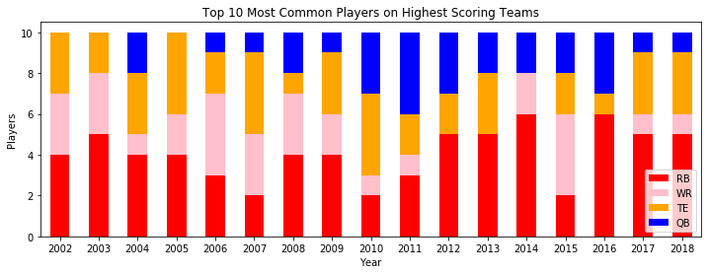
Surprisingly, as quarterbacks fantasy scoring has been rising over the years and running back scoring seems to be falling, running backs are becoming more common on the highest scoring teams.

Slide 33
Conclusions
The simulations used here are not perfect representations of actual fantasy football leagues and having the highest scoring team does not necessarily equate to winning in a standard format that uses win / loss records versus other teams in the league. However, having the highest scoring team in your league will certainly improve your odds. To that end, the notion of running back being the top targets in fantasy drafts has been prevalent for many years and my analysis indicates that this holds true today.

Slide 34
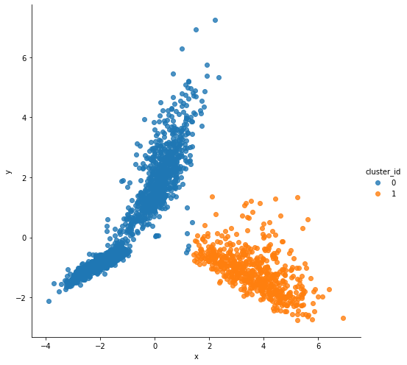
K-means clustering:
K = 2
Explained Variance: 0.754
Cluster 0 count: 1972
Cluster 1 count: 573
 | 0 | 1
PASS YDS | 4.48 | 3136.65
PASS TDS | 0.05 | 19.53
INT | 0.02 | 11.67
RUSH YDS | 339.08 | 148.95
RUSH TDS | 2.42 | 1.43
REC | 52.74 | 0.15
REC YDS | 636.28 | 0.60
REC TDS | 4.07 | 0.01
FUM LST | 0.83 | 2.87
PTS / GM | 9.19 | 14.37

Slide 35
K = 4
Explained Variance: 0.754
Cluster 0 count: 864
Cluster 1 count: 571
Cluster 2 count: 671
Cluster 3 count: 439
 | 0 | 1 | 2 | 3
PASS YDS | 5.96 | 3143.41 | 8.51 | 0.91
PASS TDS | 0.05 | 19.58 | 0.08 | 0.02
INT | 0.02 | 11.70 | 0.03 | 0.02
RUSH YDS | 56.32 | 147.72 | 912.08 | 20.51
RUSH TDS | 0.27 | 1.43 | 6.71 | 0.09
REC | 53.43 | 0.15 | 31.94 | 82.95
REC YDS | 675.61 | 0.60 | 255.58 | 1137.85
REC TDS | 4.20 | 0.01 | 0.98 | 8.53
FUM LST | 0.47 | 2.87 | 1.47 | 0.58
PTS / GM | 6.78 | 14.38 | 11.20 | 10.87

Slide 36
WR & TE Only:
K = 2
Explained Variance: 0.489
Cluster 0 count: 799
Cluster 1 count: 405
 | 0 | 1
PASS YDS | 1.40 | 0.97
PASS TDS | 0.02 | 0.02
INT | 0.01 | 0.02
RUSH YDS | 19.50 | 15.74
RUSH TDS | 0.12 | 0.06
REC | 54.84 | 84.65
REC YDS | 716.12 | 1168.19
REC TDS | 4.63 | 8.54
FUM LST | 0.43 | 0.61
PTS / GM | 6.86 | 11.01

